Slide 1

Copyright © www.ITbodhi.com

Slide 2
Support Vector Machine is one of the most performant off-the-shelf supervised machine learning algorithms.
This means that when you have a problem and you try to run a SVM on it, you will often get pretty good results without many tweaks, because it is based on a strong mathematical background.
Copyright © www.ITbodhi.com

Slide 3
SVMs are the result of the work of several people over many years. The first SVM algorithm is attributed to Vladimir Vapnik in 1963
Copyright © www.ITbodhi.com

Slide 4
SVMs have been successfully used in three main areas:
Text categorization
Image recognition
Bioinformatics
Specific examples include classifying
News stories
Handwritten digit recognition
Cancer tissue samples.
Copyright © www.ITbodhi.com

Slide 5
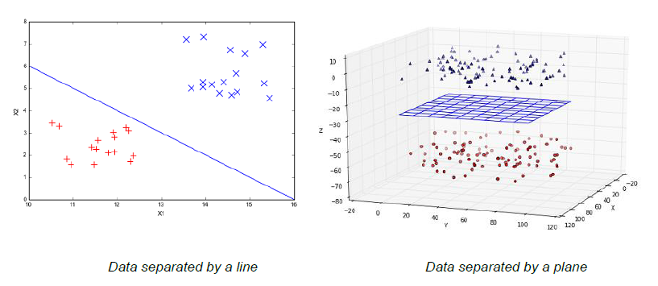
Linearly separable data
Copyright © www.ITbodhi.com

Slide 6
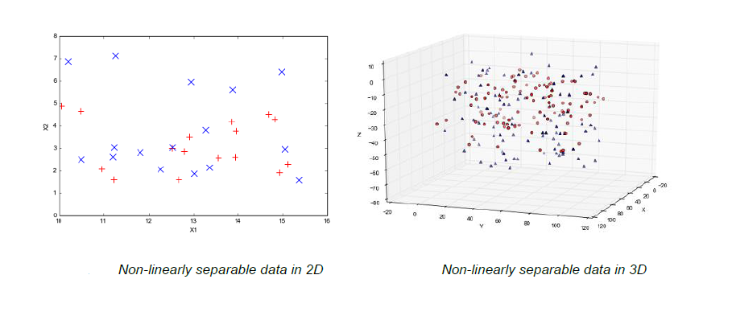
Non-Linearly separable data
Copyright © www.ITbodhi.com

Slide 7


What is a hyperplane?
In geometry, a hyperplane is a subspace of one dimension less than its ambient space.
Copyright © www.ITbodhi.com

Slide 8
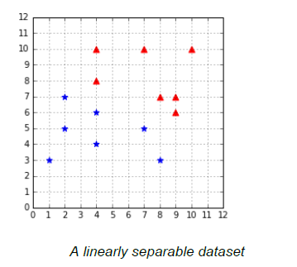
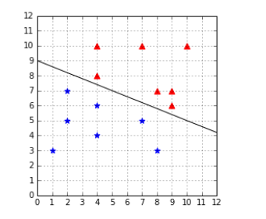
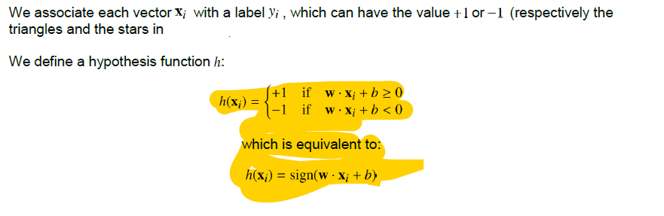
Classifying data with a hyperplane
Copyright © www.ITbodhi.com

Slide 9
SVMs search for the optimal hyperplane
Copyright © www.ITbodhi.com

Slide 10
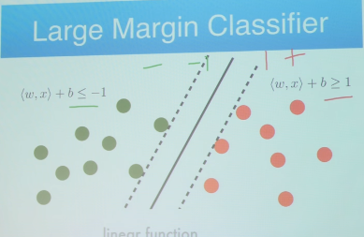
Above the line, the equation returns a value greater than 0 and the point belongs to the first class (class 0).
Below the line, the equation returns a value less than 0 and the point belongs to the second class (class 1).
A value close to the line returns a value close to zero and the point may be difficult to classify.
If the magnitude of the value is large, the model may have more confidence in the prediction.
Copyright © www.ITbodhi.com

Slide 11
Large Margin Intuition
In logistic regression, we take the output of the linear function and squash the value within the range of [0,1] using the sigmoid function. If the squashed value is greater than a threshold value(0.5) we assign it a label 1, else we assign it a label 0.
In SVM, we take the output of the linear function and if that output is greater than 1, we identify it with one class and if the output is -1, we identify is with another class. Since the threshold values are changed to 1 and -1 in SVM, we obtain this reinforcement range of values([-1,1]) which acts as margin.
Copyright © www.ITbodhi.com

Slide 12
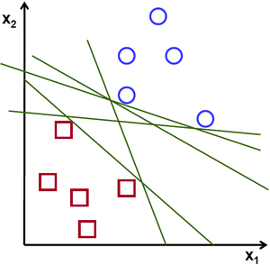
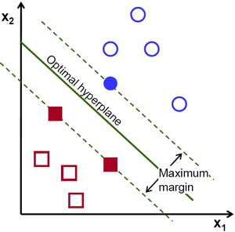
To separate the two classes of data points, there are many possible hyperplanes that could be chosen.
Our objective is to find a plane that has the maximum margin, i.e the maximum distance between data points of both classes.
Maximizing the margin distance provides some reinforcement so that future data points can be classified with more confidence.
Copyright © www.ITbodhi.com

Slide 13
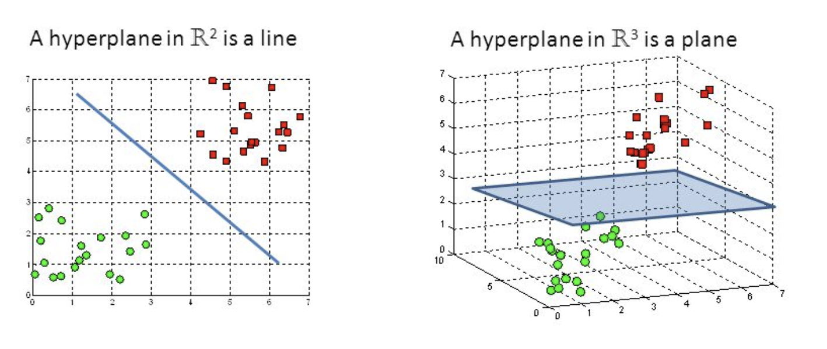
To separate the two classes of data points, there are many possible hyperplanes that could be chosen.
Our objective is to find a plane that has the maximum margin, i.e the maximum distance between data points of both classes.
Maximizing the margin distance provides some reinforcement so that future data points can be classified with more confidence.
Copyright © www.ITbodhi.com

Slide 14
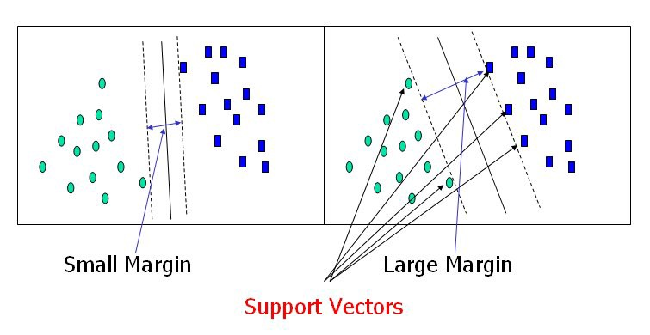
Copyright © www.ITbodhi.com

Slide 15
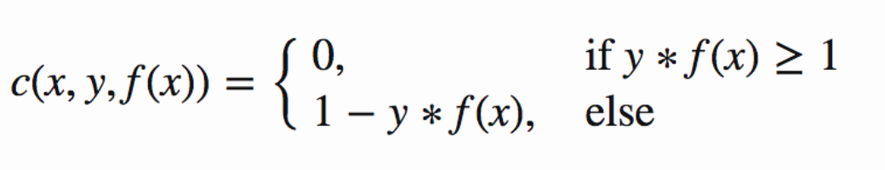
Cost Function
In the SVM algorithm, we are looking to maximize the margin between the data points and the hyperplane. The loss function that helps maximize the margin is hinge loss
.
Copyright © www.ITbodhi.com

Slide 16
Soft Margin SVM
Dealing with noisy data
The biggest issue with hard margin SVM is that it requires the data to be linearly separable. Real-life data is often noisy. Even when the data is linearly separable, a lot of things can happen before you feed it to your model. Maybe someone mistyped a value for an example, or maybe the probe of a sensor returned a crazy value. In the presence of an outlier (a data point that seems to be out of its group), there are two cases: the outlier can be closer to the other examples than most of the examples of its class, thus reducing the margin, or it can be among the other examples and break linear separability.
Copyright © www.ITbodhi.com

Slide 17
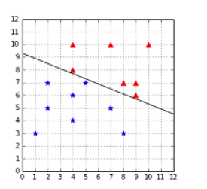
Outlier reducing the margin
When the data is linearly separable, the hard margin classifier does not behave as we would like in the presence of outliers.
In this case, we can see that the margin is very narrow, and it seems that the outlier is the main reason for this change. Intuitively, we can see that this hyperplane might not be the best at separating the data, and that it will probably generalize poorly.
Copyright © www.ITbodhi.com

Slide 18
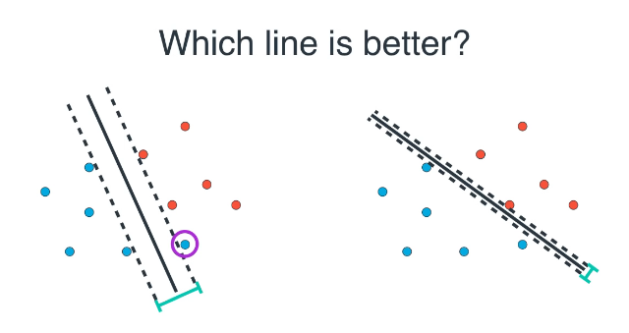

Slide 19
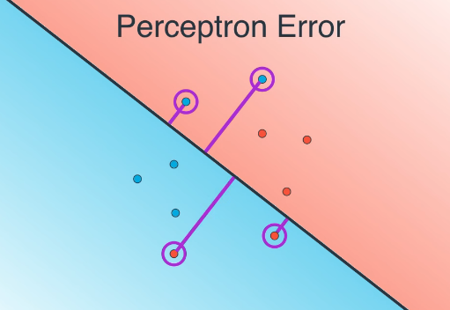

Slide 20
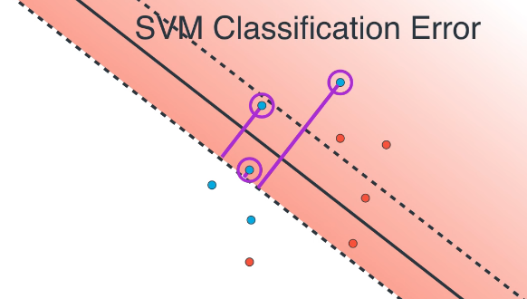

Slide 21
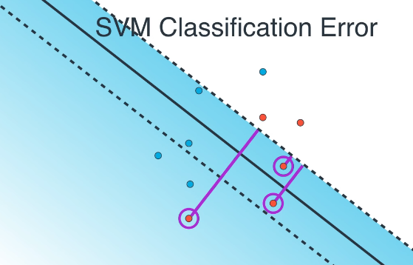
Two types of error in SVM
Classification Error
Margin Error

Slide 22
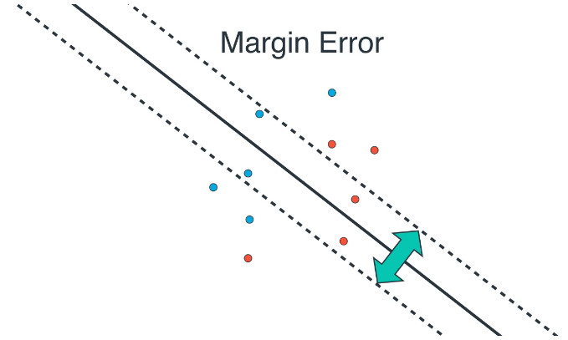

Slide 23
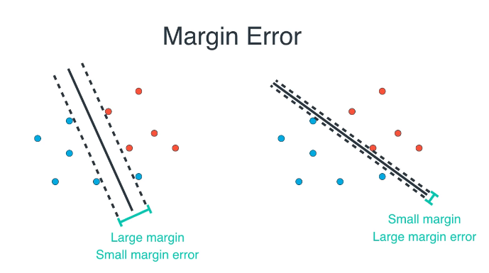

Slide 24
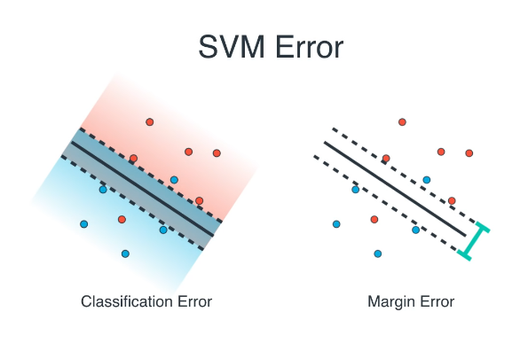

Slide 25
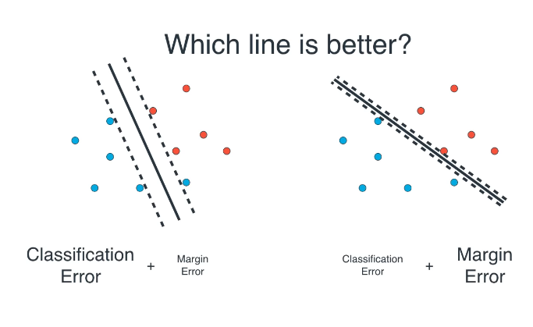

Slide 26
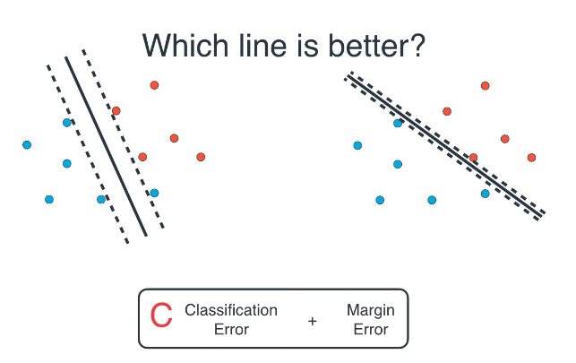

Slide 27
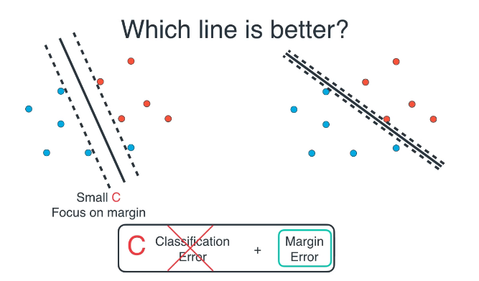

Slide 28
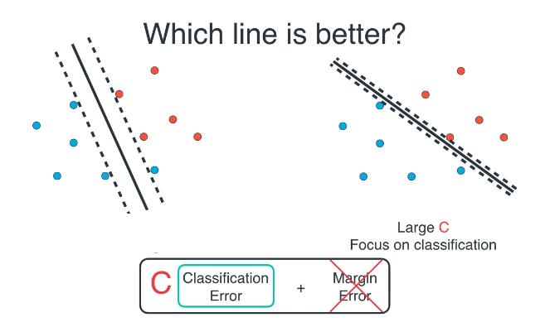
C acts as a Regularization Parameter that prevent overfitting by taking tradeoff between Classification error and Margin error.

Slide 29
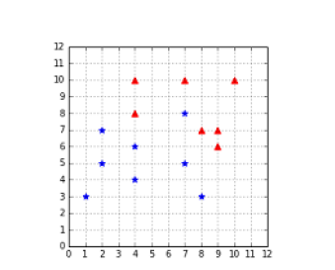
Outlier breaking linear separability
Even worse, when the outlier breaks the linear separability, the classifier is incapable of finding a hyperplane. We are stuck because of a single data point.
Copyright © www.ITbodhi.com

Slide 30
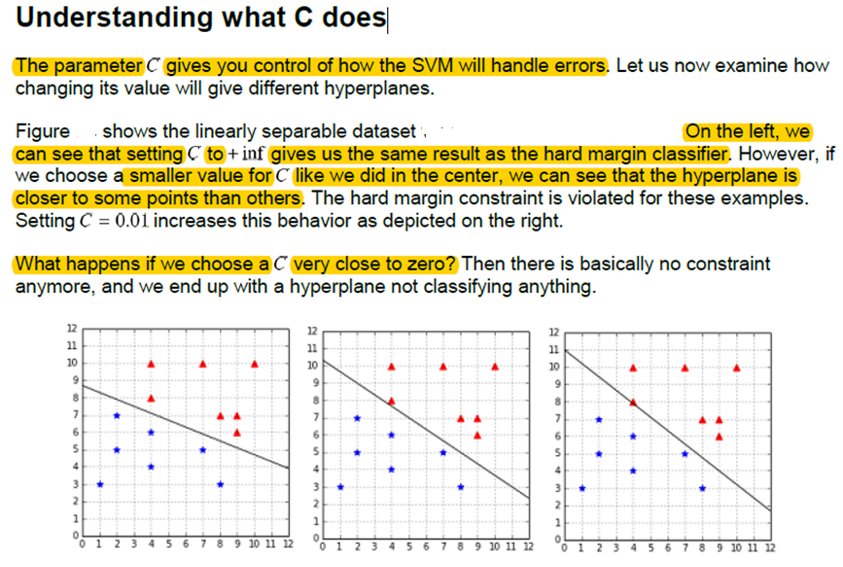
Copyright © www.ITbodhi.com

Slide 31
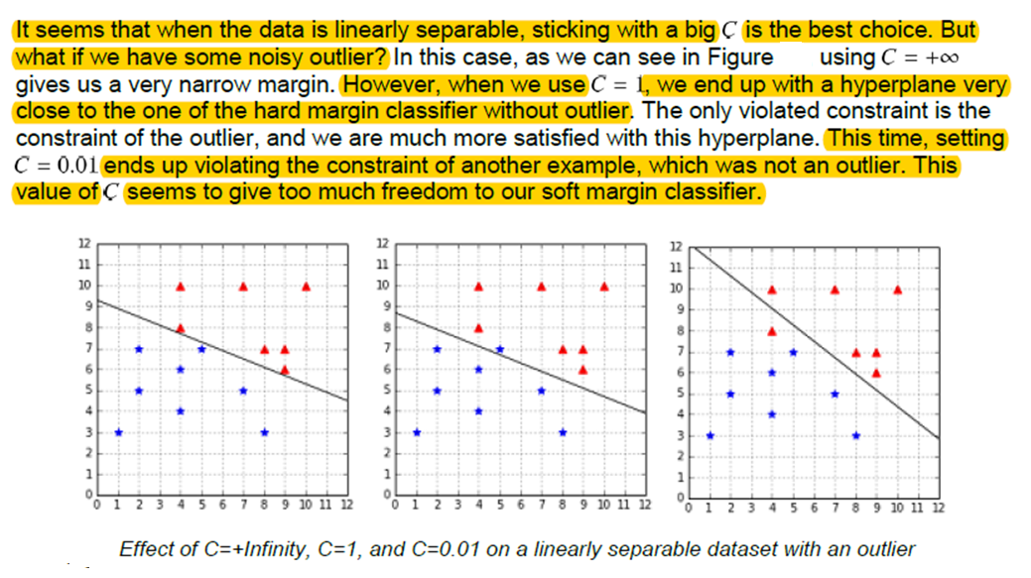
Copyright © www.ITbodhi.com

Slide 32
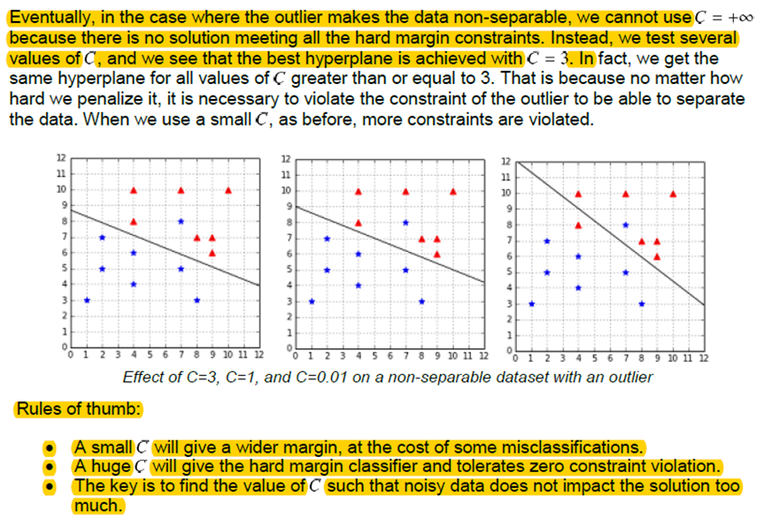
Copyright © www.ITbodhi.com

Slide 33
How to find the best C?
There is no magic value for that will work for all the problems. The recommended approach to select is to use grid search with cross-validation
Copyright © www.ITbodhi.com

Slide 34
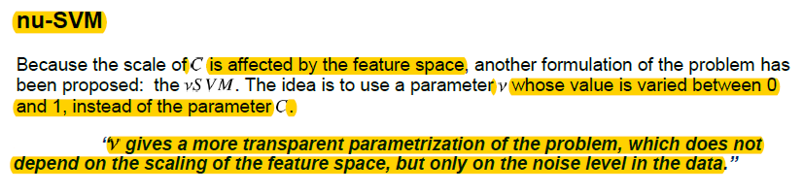
Copyright © www.ITbodhi.com

Slide 35
Kernels
Feature Transformation
Copyright © www.ITbodhi.com

Slide 36
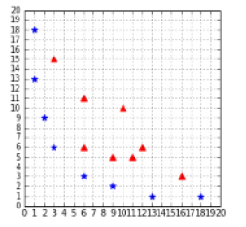
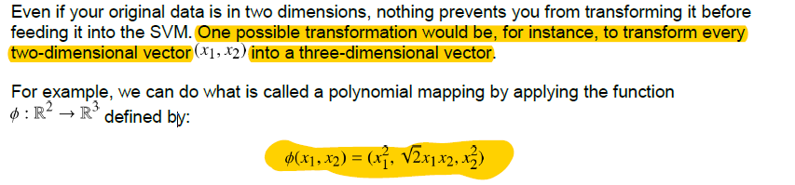
Can we classify non-linearly separable data?
Imagine you have some data that is not separable and you would like to use SVMs to classify it. We have seen that it is not possible because the data is not linearly separable. However, this last assumption is not correct. What is important to notice here is that the data is not linearly separable in two dimensions.
Copyright © www.ITbodhi.com

Slide 37
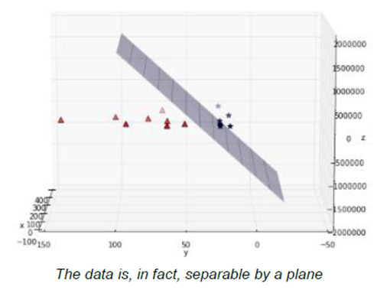
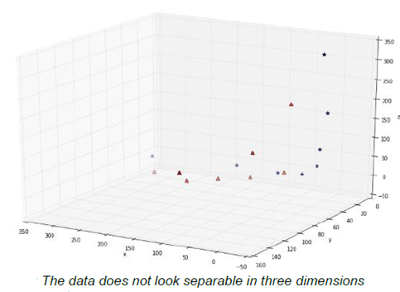
If you transform the whole data set of Last Figure and plot the result after transformation, you get below Figure, which does not show much improvement. However, after some time playing with the graph, we can see that the data is, in fact, separable in three dimensions
Copyright © www.ITbodhi.com

Slide 38
Here is a basic recipe we can use to classify this dataset:
1. Transform every two-dimensional vector into a three-dimensional vector using the transform method of Code Listing 31.
2. Train the SVMs using the 3D dataset.
3. For each new example we wish to predict, transform it using the transform method before passing it to the predict method.
Of course, you are not forced to transform the data into three dimensions; it could be five, ten, or one hundred dimensions.
How do we know which transformation to apply?
Choosing which transformation to apply depends a lot on your dataset. Being able to transform the data so that the machine learning algorithm you wish to use performs at its best is probably one key factor of success in the machine learning world. Unfortunately, there is no perfect recipe, and it will come with experience via trial and error.
Copyright © www.ITbodhi.com

Slide 39
What is a kernel?
In the last section, we saw a quick recipe to use on the non-separable dataset. One of its main drawbacks is that we must transform every example.
If we have millions or billions of examples and that transform method is complex, that can take a huge amount of time.
This is when kernels come to the rescue.
Copyright © www.ITbodhi.com

Slide 40
The question is this:
Is there a way to compute this value, without transforming the vectors?
And the answer is: Yes, with a kernel!
A kernel is a function that returns the result of a dot product performed in another space.
Copyright © www.ITbodhi.com

Slide 41
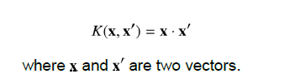
Kernel types
Linear kernel
This is the simplest kernel. It is simply defined by:
In practice, linear kernel works well for text classification.
Copyright © www.ITbodhi.com

Slide 42

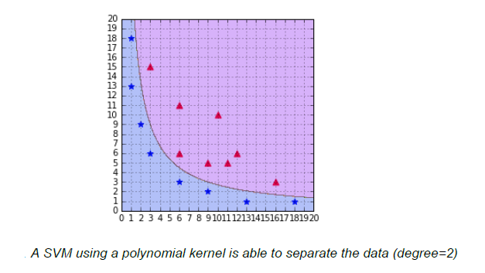
Polynomial kernel: It has two parameters which represents a constant term, and , which represents the degree of the kernel.
Copyright © www.ITbodhi.com

Slide 43
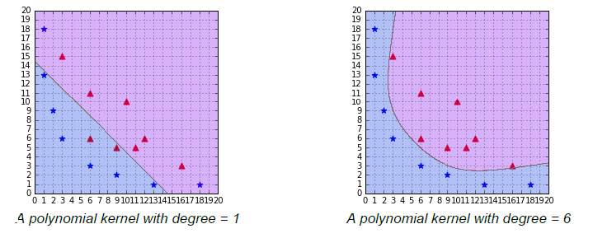
Updating the degree
A polynomial kernel with a degree of 1 and no constant is simply the linear kernel.
When you increase the degree of a polynomial kernel, the decision boundary will become more complex and will have a tendency to be influenced by individual data examples. Using a high-degree polynomial is dangerous because you can often achieve better performance on your test set, but it leads to what is called overfitting: the model is too close to the data and does not generalize well.
Copyright © www.ITbodhi.com

Slide 44
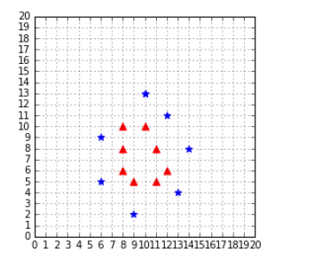
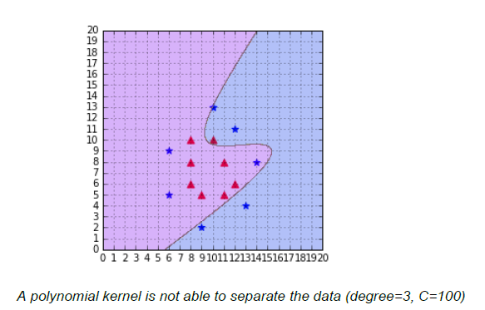
RBF or Gaussian kernel
Sometimes polynomial kernels are not sophisticated enough to work. When you have a difficult dataset like the one depicted in Figure.
Earlier kernel will show its limitation in these case.
Copyright © www.ITbodhi.com

Slide 45
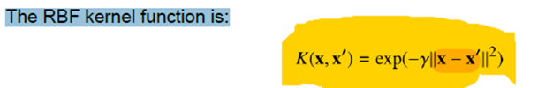
It is also named RBF kernel, where RBF stands for Radial Basis Function. A radial basis function is a function whose value depends only on the distance from the origin or from some point.
The RBF kernel function is:
Copyright © www.ITbodhi.com

Slide 46
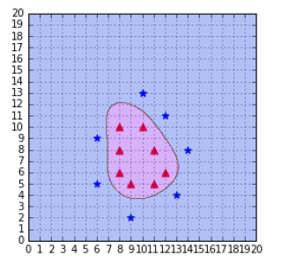
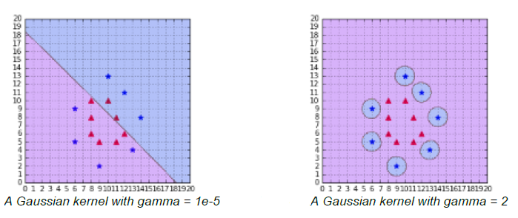
Using RBF kernel:
The RBF kernel classifies the
data correctly with gamma = 0.1
Changing the value of gamma
When gamma is too small,
the model behaves like a linear SVM.
When gamma is too large, the model
is too heavily influenced by each
support vector.
When gamma is too small, as in Figure 1, the model behaves like a linear SVM. When gamma is too is too large, the model is too heavily influenced by each support vector as shown in figure 2.
Copyright © www.ITbodhi.com

Slide 47
Which kernel should I use?
The recommended approach is to try a RBF kernel first, because it usually works well. However, it is good to try the other types of kernels if you have enough time to do so ☺
The kernel trick is one key component making Support Vector Machines powerful. It allows us to apply SVMs on a wide variety of problems even if data is non-separable.
Copyright © www.ITbodhi.com

Slide 48
Data Preparation for SVM
Numerical Inputs: SVM assumes that your inputs are numeric. If you have categorical inputs you may need to covert them to binary dummy variables (one variable for each category).
Binary Classification: Basic SVM as described in this post is intended for binary (two-class) classification problems. Although, extensions have been developed for regression and multi-class classification.
Copyright © www.ITbodhi.com

Slide 49
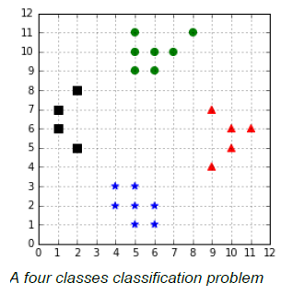
Multi-Class Classification
Using SVMs :
Copyright © www.ITbodhi.com

Slide 50
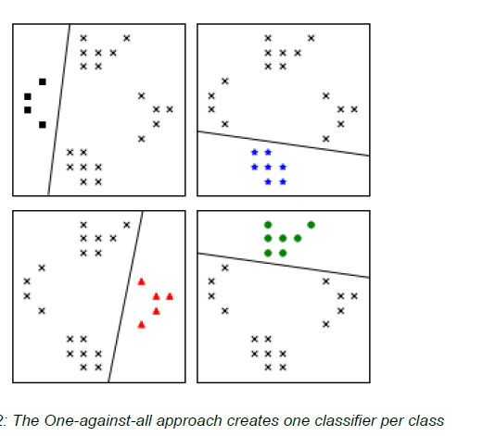
One-against-all
In order to classify K classes, we construct
K different binary classifiers.
For a given class, the positive examples are
all the points in the class, and the negative
examples are all the points not in the class.
We train one binary classifier on each problem
As a result, we obtain one decision boundary
per classifier .
In order to make a new prediction, we use each classifier and predict the class of the classifier if it returns a positive answer
Copyright © www.ITbodhi.com

Slide 51
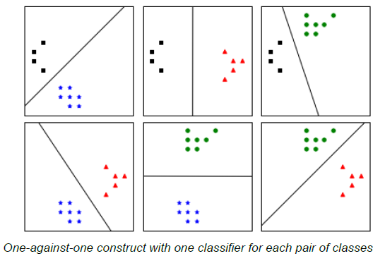
One-against-one
In this approach, instead of trying to distinguish one class from all the others, we seek to distinguish one class from another one. As a result , we train one classifier per pair of classes, which leads to K(K-1)/2 classifiers for K classes.
Predictions are made using a simple voting strategy. Each example we wish to predict is passed to each classifier, and the predicted class is recorded. Then, the class having the most votes is assigned to the example
Copyright © www.ITbodhi.com

